Slide 1

QCD111
Group3
YI-CHEN CHEN
Vigneshwar Reddy Madagam
Patsita Patcharatipsakul
Hao Wang

Slide 2
Overview: Group 3
Decision-making
Fostering Creativity in IT
1.Problem-solving
2.Creativity
3.Soft skills
4.Leadership
Innovation and Improvement
Challenges of Creativity in IT
Nurturing individual growth
Negotiation
Inspiring the team
Active listening

Slide 3
Introduction Hao Wang n11732482
Targeted skill: problem-solving

Slide 4
Key Point 1: Decision-Making
Productivity and creativity (Smith M. & Johnson S., 2016).
Enhances decision-making.

Slide 5
Key Point 2: Innovation and Improvement
Problem-solving fosters innovation and improvement (Anderson A., et al., 2020).
Generate creative solutions and suggest process improvements.

Slide 6

Summary of Problem-solving

Slide 7
Creativity Yi-CHEN CHEN

Slide 8
Creativity
N11564628
Key Point 1
Fostering Creativity in IT
(Collin et al. ,2018; Zhou et al. , 2014)
Key Point 2
Challenges of Creativity in IT
(Zhou et al., 2014)

Slide 9
Fostering Creativity in the IT Industry
N11564628
Preventing errors
during information transformation
Communication
between different departments
Notes:
Preventing errors
during information transformation
Communication
Between
different departments

Slide 10
Challenges of Creativity in IT
N11564628
Challenge
1. Ddeviations from project instructions
(Zhou et al. , 2014)
2. Cconflicts of ideas
Solution
Reliable and practicable system

Slide 11

Summary of Creativity

Slide 12

Soft skills Patsita Patcharatipsakul N11499630
Personality traits and Interpersonal abilities
Defined as as “Individual’s Relationship”

Slide 13



Key point 1 : Negotiation
N11499630
Mutually beneficial agreements
Implement strategies (Kychko et al. ,2021)
Navigate complex situations (Kychko et al. ,2021)
Bring balance to the organisation
(Kychko et al. ,2021)
(Flaticon, n.a.)

Slide 14


Key point 2: Active listening
N11499630
Focusing and engaging on the speakers
Clearly requirements ( Helens-Hart and Engstrom, 2021)
Accurately perspectives and emotions ( Helens-Hart and Engstrom, 2021)
Verbal and Nonverbal signs
(Flaticon, n.a.)

Slide 15

Real-Life experienced
(Mixetto, 2023)

Slide 16

Summary of soft skills
(Hume, 2018)

Slide 17
Leadership
Vigneshwar Reddy Madagam (N11402644)

Slide 18

What is Leadership?
(N11402644)
Leadership Goal
Qualities of a good leader.
Goals for today
(sung, 2017)

Slide 19
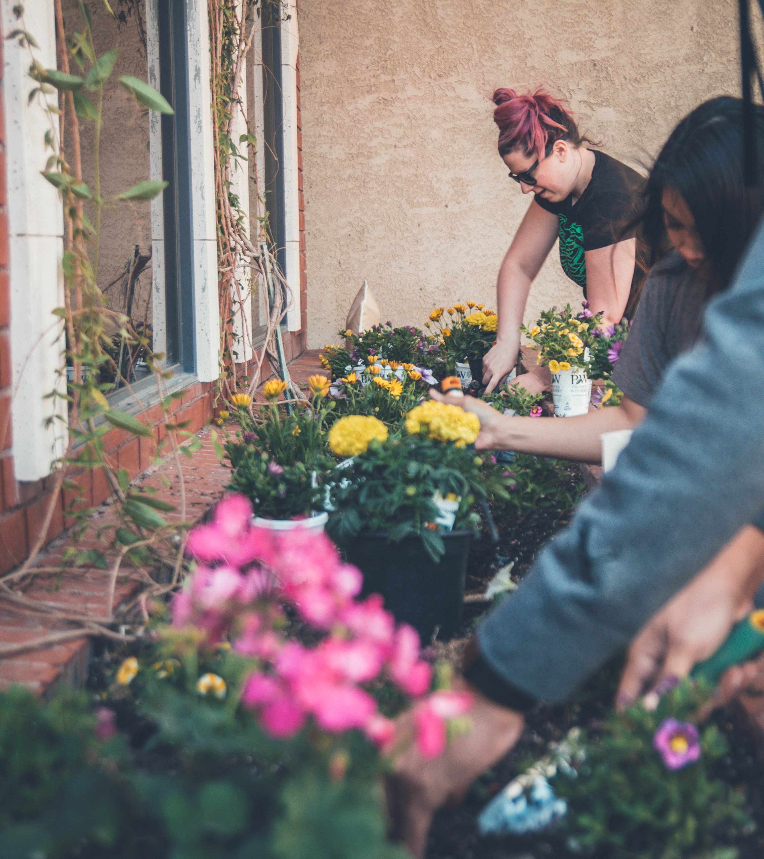
Nurturing Individual Growth
(N11402644)
The ideal leader.
Key focus area.
Ultimate goal.
(Dong et al., 2016)
(Eliason, 2018)

Slide 20

Inspiring the Team
(N11402644)
Leader's influence.
Key actions.
Positive outcomes.
(Adam et al., 2023)
Gong et al. (2009)
(Distel, 2019)

Slide 21

The Impact of Creative Leadership
(N11402644)
Impact of Creative Leadership.
Methods.
Benefits.
Key to Unlocking Creativity
(Mars, 2018)

Slide 22

Summary for Leadership
(N11402644)

Slide 23

Conclusion

Slide 24

Thank you ☺

Slide 25
Reference Lists
Alarifi, G., & Adam, N. A. (2023). The role of participatory leadership and employee innovative behavior on SMEs’ endurance. Sustainability, 15(3), 2740. https://doi.org/10.3390/su15032740
Alice Anderson, M. (2020). Using emotional intelligence to improve perioperative teamwork. AORN Journal, 111(6), P19–P20. https://doi.org/10.1002/aorn.13086
Collin, K., Herranen, S., Paloniemi, S., Auvinen, T., Riivari, E., Sintonen, T., & Lemmertty, S. (2018). Leadership as an enabler of professional agency and creativity: case studies from the Finnish information technology sector. International Journal of Training and Development, 22(3), 222–232. https://doi.org/10.1111/ijtd.12130
Dong, Y., Bartol, K. M., Zhang, Z., & Li, C. (2016). Enhancing employee creativity via individual skill development and team knowledge sharing: Influences of dual-focused transformational leadership. Journal of Organizational Behavior, 38(3), 439–458. https://doi.org/10.1002/job.2134
Du, J., Lin, X., Cai, Y., Sun, F., & Amankwah-Amoah, J. (2022). When Teamwork Works: Examining the Relationship Between Leader-Member Exchange Differentiation and Team Creativity. Frontiers in Psychology, 12, 646514–646514. https://doi.org/10.3389/fpsyg.2021.646514
Gong, Y., Huang, J., & Farh, J. (2009). Employee learning orientation, transformational leadership, and employee Creativity: the mediating role of employee Creative Self-Efficacy. Academy of Management Journal, 52(4), 765–778. https://doi.org/10.5465/amj.2009.43670890

Slide 26
Reference Lists
Helens-Hart, R., & Engstrom, C. (2021). Empathy as an essential skill for talent development consultants. The Journal of Workplace Learning, 33(4), 245–258. https://doi.org/10.1108/JWL-06-2020-0098
Kychko, І., Parubets, О., Kholodnytska, А., Perminova, V., & Lytvyn, S. (2021). Formationof managerial competencies of managers and their impact on the competitiveness of the firm and the labour market in Ukraine. Financial and Credit Activity Problems of Theory and Practice, 4(39), 284–293. https://doi.org/10.18371/fcaptp.v4i39.241317
L’Heureux, J., Boisvert, D., Cohen, R., & Sanghera, K. (2012). IT problem solving: an implementation of computational thinking in information technology. Proceedings of the 13th Annual Conference on Information Technology Education, 183–188. https://doi.org/10.1145/2380552.2380606
Smith, Johnson, R. H., Macpherson, C. F., A. W., Block, R. G., & Keyton, J. (2016). Facilitating teamwork in adolescent and young adult oncology. Journal of Oncology Practice, 12(11), 1067–1074. https://doi.org/10.1200/JOP.2016.013870
Sweeney, R.B. (2003). Creativity in the information technology curriculum proposal. CITC4 '03. https://doi.org/10.1145/947121.947153
Zhou, C., Chen, H., & Luo, L. (2014). Students’ perceptions of creativity in learning Information Technology (IT) in project groups. Computers in Human Behavior, 41, 454 463. https://doi.org/10.1016/j.chb.2014.09.058

Slide 27
Reference Lists
https://unsplash.com/photos/FWVMhUa_wbY -(Mars, 2018)
https://unsplash.com/photos/wD1LRb9OeEo - (Distel, 2019)
https://unsplash.com/photos/qo6_mo9dsYg -(Elison, 2018)
https://unsplash.com/photos/Hcfwew744z4 -(Hume, 2018)
https://www.istockphoto.com/photo/female-coworkers-working-together-in-small-offfice-gm1454460679-490113322?phrase=customer+support (Mixetto, 2023)

Slide 28
Video link
https://connectqutedu-my.sharepoint.com/:v:/g/personal/n11564628_qut_edu_au/EZHAlQyCsfZOrf54vIf5x2wB7_B8U4iSTkmO8RBSrnkVEg?nav=eyJyZWZlcnJhbEluZm8iOnsicmVmZXJyYWxBcHAiOiJPbmVEcml2ZUZvckJ1c2luZXNzIiwicmVmZXJyYWxBcHBQbGF0Zm9ybSI6IldlYiIsInJlZmVycmFsTW9kZSI6

